Slide 1
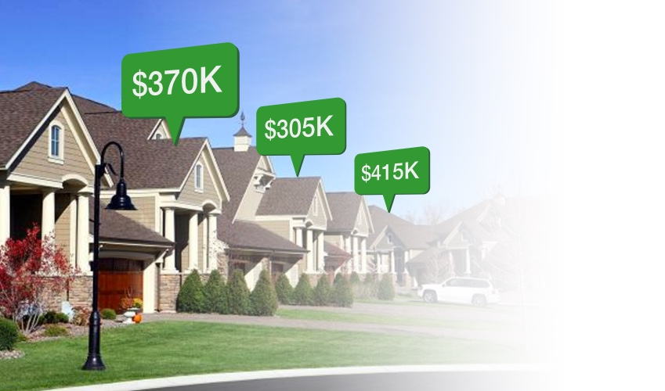

House Price Prediction
Analysis
DATA_606 Capstone in Data Science
Chaojie Wang
By
Sathyam Chanumolu
UMBC

Slide 2
Agenda
Discussion on business problem.
Understanding of dataset and features.
Data preparation, cleaning, and outlier analysis.
Exploratory data analysis and insight generation.
Feature selection and machine learning modelling.
UMBC

Slide 3
Citations
Real estate is a recognized sector globally, and provide huge employment in countries like US, and India.
House price determination is a huge challenge as several factors influenced it to a huge extent.
Either it is real estate investor or buyer everyone wants to determine the proper cost of a house.
Determination of house price not only influenced the buyer, or seller, But also impacts a lot to the loan providers such as banks and loan institution. Determining correct price will make sure it won’t go into NPA (Non-Performing Asset).
Many hidden factors can reduce or increase the price into a great extent, which can be determined using proper statistical analysis.
UMBC

Slide 4
Business Understanding
Problem statement:
A house more than an enclosed area.
Intelligent buyers always look into the external factors other than the house quality and condition, such as neighborhood, connectivity etc.
For sellers also the actual market price of the house should be known. Otherwise, they may sell at very low cost as well.
The objective here is to predict the correct price/close price of the house by looking into the factors given in the dataset.
UMBC

Slide 5
Dataset
feature | description
cid | Notion of a house
dayhours | Date house was sold
price | Price of the house (target)
Room_bed | Number of bedrooms in the house
Room_bath | Number of bathrooms in the house
Living_measure | Square foot of the home
Lot_measure | Quare footage of the lot
ceil | Total floors (levels) in the house
coast | House which has a view to waterfront
sight | Has been viewed
Condition | How good the condition is (overall)
quality | Grade given to the housing unit
There are total 22 input variable and 1 output variable present in the dataset.
Data description is given below.
feature | description
cid | Notion of a house
dayhours | Date house was sold
price | Price of the house (target)
Room_bed | Number of bedrooms in the house
Room_bath | Number of bathrooms in the house
Living_measure | Square foot of the home
Lot_measure | Quare footage of the lot
UMBC

Slide 6
Dataset
feature | description
Ceil_measure | Square footage of the house apart from basement
basement | Square footage of the basement
Yr_built | Build year
Yr_renovated | Year when house was renovated
zipcode | zip
lat | Latitude coordinate
long | Longitude coordinate
Living_measure15 | Living room area in 2015 after renovation
Lot_measure15 | Lot size area in 2015(implies – some renovation)
furnished | Based on the quality of the room
Total_area | Measure of both living and lot
UMBC

Slide 7
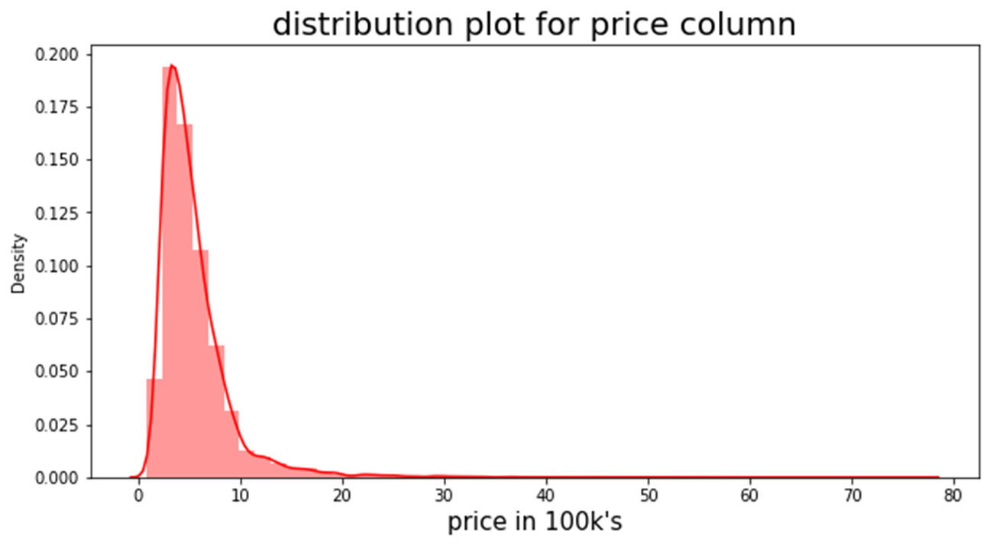
Project Framework
This is a regression problem with target variable = price
Regression predictive modelling is the task of approximating a mapping function (f) from input variables (x) to a continuous output (target) variable (y).
UMBC

Slide 8
Data cleaning
In EDA, I have performed several techniques, and which is described below.
Null value treatment-
Numeric variable – mean (when outliers doesn’t impact much effect), median(when distribution is almost normal)
Categorical variable – based on the logics of other features relation, mode of the class.
Non of the feature were more than 5% null value present. So, no row removal done.
Duplicate data count –
No duplicate rows were found.
UMBC

Slide 9
Exploratory data analysis (Cntd.)
Univariate analysis-
Numerical columns – distribution plot
Categorical columns – count plot
Bivariate and multivariate analysis-
Scatter plot between all continuous data and target column to detect pattern
Box plot of price data with all categorical labels to see any trend in categories
Distribution plot label wise to check the distribution of each class separately
Factor plot to check pattern in paired columns
Applied central limit theorem to understand mean of the distribution following normality
UMBC

Slide 10
Exploratory data analysis (Cntd.)
Outlier analysis-
Boxplot analysis to detect outliers present in the univariate features
BDSCAN clustering – to detect outliers between target variable and the numerical features
Test and data transformation-
Transform categorical data into noir categories.
Tog transformation of right skewed features to check evidence gaussian distribution.
Q-Q plot test to check features following normality.
One-hot encoding, label encoding, and standard scaler data transformation has been used.
UMBC

Slide 11
High level finding from EDA
There are total 21613 number of unique data present in the dataset.
The house price range is between 75000 and 7700000.
All the house details belongs to us state Washington and king county.
Most of the house details belong to Seattle city.
Almost all input continuous features are right skewed.
None of the continuous feature follows normality.
Living measure, house furnishment, quality are the top features which impact the price of the house.
There are positive trend in house price with the number of views, total number of bedroom, bathroom and floors.
House condition has no impact with the price, which depicts the condition has not much impact.
Datetime of the year has no impact on price of the house. It is irrelevant.
UMBC

Slide 12
Feature selection
The approaches has been used for feature selection.
Select k-best method-
This method used various statistical test to determine the best features which can be used for model building.
Selected top 15 important features for model building.
UMBC

Slide 13
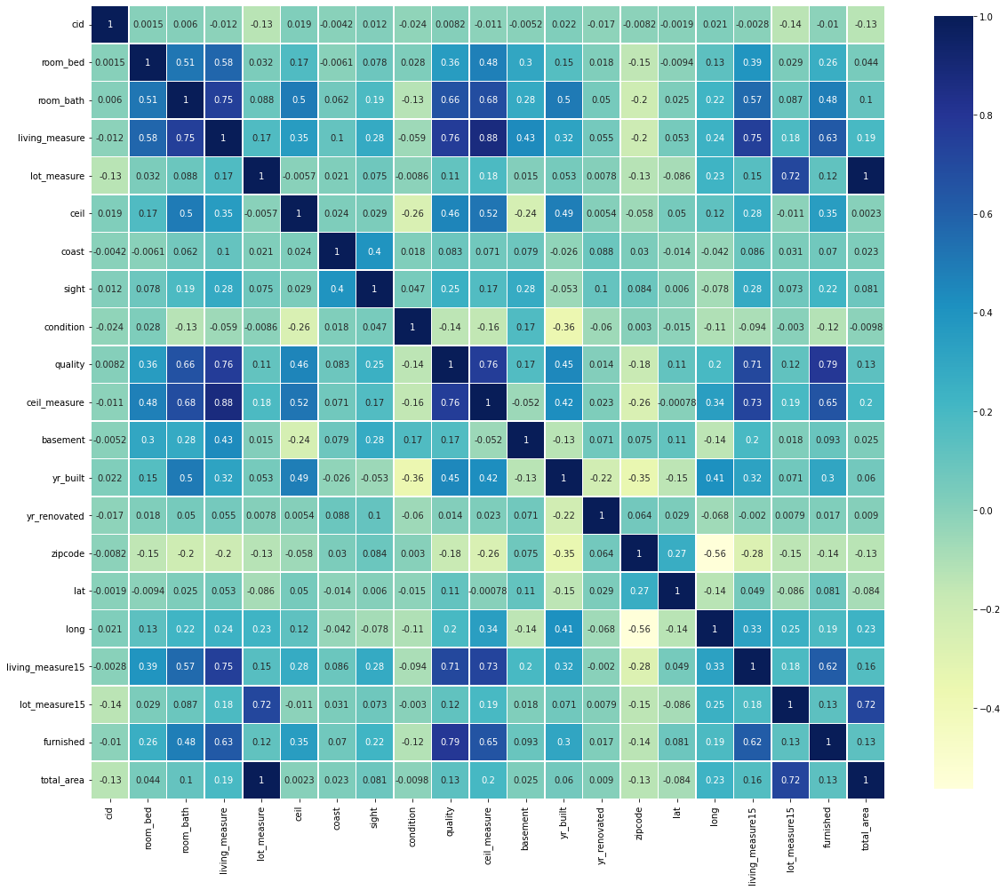
Correlation
My target column is price. From this heatmap the potential features for machine learning are living_measure, quality, ceil_measure, living_measure15, furnished etc.,
UMBC

Slide 14
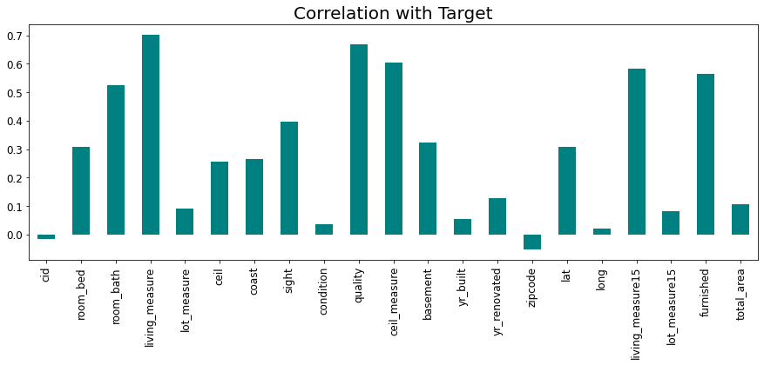
Correlation plot with output
Living measure has the highest correlation with the output which is more than 0.7.
UMBC

Slide 15
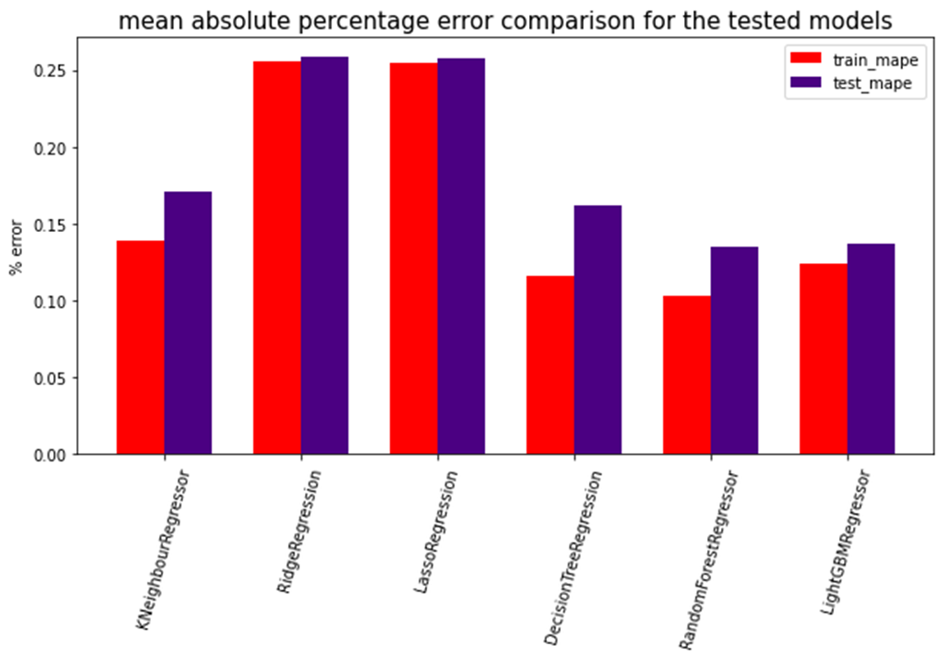
Machine learning modelling
Below selected models has been used for machine learning modelling for both k-best features and PCA.
K-neightbour regressor
Lasso regression
Ridge regression
Decision tree
Random forest
Light GBM
UMBC

Slide 16
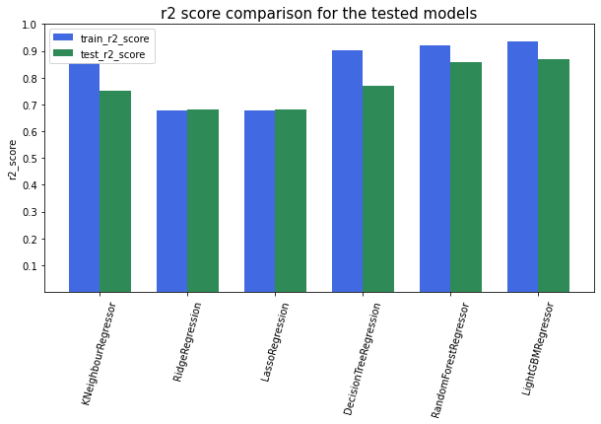
Machine learning modelling-
R2 score for the mentioned model for k-best models
UMBC

Slide 17
Comparison of model performance measure on k-best features
Model | Train_mae | Test_mae | Train_mape | Test_mape | Train_r2 | Test_r2
KNN | 75559.20 | 92331.07 | 0.1385 | 0.1706 | 0.8533 | 0.7509
RIDGE | 127879.14 | 128651.69 | 0.2554 | 0.2582 | 0.6762 | 0.6816
LASSO | 127713.31 | 128504.83 | 0.2549 | 0.2578 | 0.6762 | 0.6817
Decision Tree | 62653.11 | 89203.98 | 0.1161 | 0.1623 | 0.9012 | 0.7686
Random Forest | 54760.27 | 72060.10 | 0.1032 | 0.1353 | 0.9210 | 0.8568
Light GBM | 60924.34 | 71514.68 | 0.1240 | 0.1370 | 0.9349 | 0.8706
UMBC

Slide 18

UMBC

